Slide 1
CSC 453 Database Systems
Lecture
Tanu Malik
College of CDM
DePaul University

Slide 2
Mid-term Exam
Date: Oct 15th (in-class) OL: Oct 13th-Oct 16th
Syllabus: Everything upto October 8th
Guidance: Study guide
Time: 135 minutes
Venue: Class
Format: Paper-based, multiple-choice, multi-select questions
Allowed: 1 sheet of A4 size typed/handwritten notes
Partial grading

Slide 3
If you are waking up late
Course Website:
  http://facsrv.cs.depaul.edu/~tmalik1/teaching/csc453/index.html
  FAQs

Slide 4
Quiz Errata
Consider a social network of users in which each user has a 'friend' relationship with other users.
Errata: None of them are correct.
Create table SNUser(
userid integer
);
Create table Friend(
Userid integer,
friendid integer,
foreign key (userid) references SNUser(userid),
foreign key (friendid) references SNUser(userid)
);

Slide 5
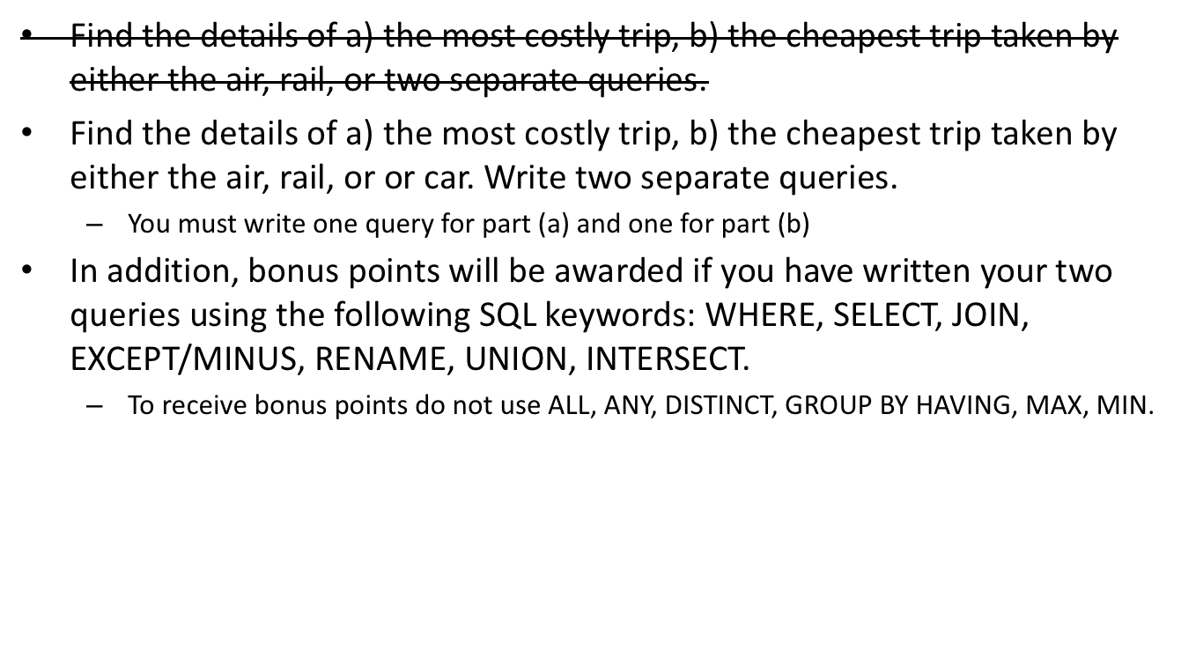
HW 1 PartC Q10 Errata

Slide 6
Last time
SQL
  Basic SQL on single table
  Basic SQL on two tables

Slide 7
Today
SQL
  Review
  Basic SQL on two tables
  Subqueries
    Nested subqueries
    Correlated subqueries
  Update, Delete statements
Creating Views
  Temporary Tables
Recursion

Slide 8
SQL Review
Queries on a single table
SELECT
FROM
WHERE
GROUP BY
HAVING
ORDER BY

Slide 9
SQL Review
Find how many students joined the University in 2008?

Slide 10
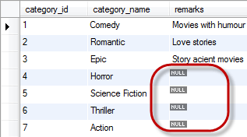
SQL NULLs Review
Given this data, what will the following query return
Select count(*) from Movies
Select count(remarks) from Movies

Slide 11
SQL: Review
Queries on two tables
Join
Cross Join
Outer join (Left, Right, Full)

Slide 12

Joins
T1
T2
T2
T1
T1
T2
T2
T1

Slide 13
Another SQL Query
List all students who are enrolled in courses.
List all students who are not enrolled in a course.

Slide 14
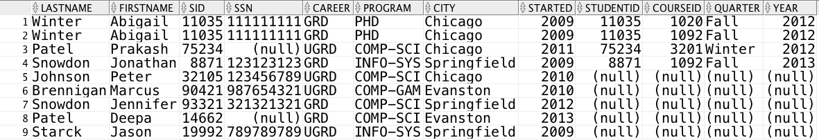

Slide 15
DIFFERENCE Operation
Subtract

Slide 16
SQL: EXCEPT/MINUS
The SQL EXCEPT clause/operator is used to combine two SELECT statements and returns rows from the first SELECT statement that are not returned by the second SELECT statement.
SELECT column1 [, column2 ]
  FROM table1 [, table2 ]
  [WHERE condition]
  EXCEPT
  SELECT column1 [, column2 ]
  FROM table1 [, table2 ]
  [WHERE condition]

Slide 17
SQL
SELECT sid
FROM student left outer join course
MINUS
SELECT studentid
FROM enrolled
OR
SELECT sid
FROM student left outer join course where courseid is null
But courseid must not be null in Enrolled

Slide 18
Practice
List student members of DeFrag and HerCTI.

Slide 19
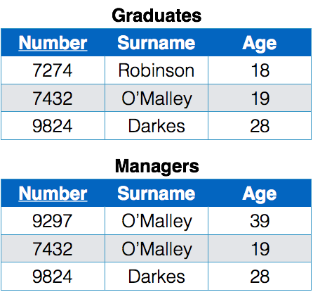
UNION Operation
Students1
Number | Surname | Age
9297 | O’Malley | 39
7432 | O’Malley | 19
9824 | Darkes | 28
7274 | Robinson | 18
Students2

Slide 20
SQL: UNION
The UNION operator is used to combine the result-set of two or more SELECT statements.
Each SELECT statement within UNION must have the same number of columns
The columns must also have similar data types
The columns in each SELECT statement must also be in the same order
SELECT column_name(s) FROM table1
UNION
SELECT column_name(s) FROM table2;

Slide 21
Mixed Practice
List students that are members of both DeFrag and HerCTI groups.

Slide 22
INTERSECT Operation
Students 1
Number | Surname | Age
7432 | O’Malley | 19
9824 | Darkes | 28
Students2

Slide 23
SQL: Intersect
Combine two SELECT statements, but returns rows only from the first SELECT statement that are identical to a row in the second SELECT statement.
SELECT column1 [, column2 ]
FROM table1 [, table2 ]
[WHERE condition]
INTERSECT
SELECT column1 [, column2 ]
FROM table1 [, table2 ]
[WHERE condition]

Slide 24
Mixed Practice
We require that all gaming students are members of DeFrag; list students that violate this rule.

Slide 25
Joins for comparison: Self Join
Joins the table to itself
SELECT …
TABLE1 as Alias1, TABLE as Alias2
ON Alias1.AttributeA = Alias2.AttributeB;

Slide 26
Self-Join
List students enrolled in two or more courses
List pair of students taking the same course.

Slide 27
SQL Queries
General form of a query:
1. SELECT list of attributes to report
3. FROM list of tables [CROSS JOIN| [LEFT|REIGHT] OUTER JOIN]
2. [WHERE tuple condition]
5. [GROUP BY list of grouping attributes]
6. [HAVING group condition]
4. [ORDER BY list of ordering attributes] ;
[UNION|INTERSECT|EXCEPT]
Result is an ordered set of ordered tuples

Slide 28
Subqueries

Slide 29
Subqueries
The result of one query may be needed by another to compute its result.
There are two kinds of subqueries
  Nested subqueries in which result of a inner subquery is used by outer subquery to compute result
  Correlated query in which each tuple of outer query runs aa loop for the inner subqery.

Slide 30
Nested Subquery Example
Find out students who started the earliest.
This is not a robust way of querying
SELECT min(started)
FROM student
SELECT student.*
FROM student
WHERE started = ‘2003’

Slide 31
Nested Subquery Example
Outer query
Nest Q1 inside Q2
SELECT S1.*
FROM student S1
WHERE started = (SELECT min(S2.started)
FROM student S2)
Subquery OR
Inner query

Slide 32
Writing Nested Subqueries
A subquery is nested (using parentheses) within an outer query
Outer query uses the result of the subquery, which can be either single value or a table
Outer query checks if a tuple in the outer query is within the inner query single value or table

Slide 33
Subquery check
Different ways of checking:
  Within the inner query set
  Not within the inner query set
  Against all members of the inner query set
  Against any one member of the inner query set
  Does the set exists

Slide 34
Set Membership
(6 in {2,4,6}) = ?
(5 in {2,4,6}) = ?
(5 not in {2,4,6}) = ?
Notes:
TRUE, FALSE, TRUE

Slide 35
Set Comparison
Attribute <comp> ANY/ALL (Subquery result)
(5 < ANY {0,4,6}) = FALSE
(5 < ALL {0,2,4}) = TRUE
(5 = ANY {0,5}) = TRUE
(5 != ANY {0,5}) = ?
(5 = ALL {4,5}) = FALSE
(5 != ALL {4,6}) = ?

Slide 36

Break

Slide 37
SQL: IN
IN checks membership in a set
The set may be specified by a subquery or declared in the query
NOT IN check non-membership

Slide 38
The IN Operator
Conditions can contain IN for “element of”
SELECT LastName, FirstName
FROM student
WHERE started IN (2010, 2013, 2014);
SELECT LastName, FirstName
FROM student
WHERE started NOT IN (2010, 2013, 2014);
SELECT Department, CourseName
FROM Course
WHERE Department IN ('CSC' , 'IT', 'IS');

Slide 39
Nesting Queries with IN
SELECT LastName, FirstName, SID
FROM student
WHERE SID IN
(SELECT PresidentID
FROM studentgroup)
Examples
List all students who are members of HerCTI.
Presidents who are members of their groups.

Slide 40
NOT IN: Set Complement
Example: Students who did not enroll in 2013.
SELECT LastName, FirstName, SID
FROM student
WHERE sid NOT IN (SELECT studentID
FROM enrolled
WHERE year = 2013);

Slide 41
Example ALL/ANY
List student who started first
SELECT LastName, FirstName, SID
FROM student
WHERE started >= ALL (SELECT started
FROM student);
List students if there was another student who started before them
SELECT LastName, FirstName, SID
FROM student
WHERE started >= ANY (SELECT started
FROM student);

Slide 42
Pop Quiz
SELECT LastName, FirstName, SID
FROM student
WHERE started >= ALL (SELECT started
FROM student);
SELECT LastName, FirstName, SID
FROM student
WHERE started = (SELECT max(started)
FROM student);

Slide 43
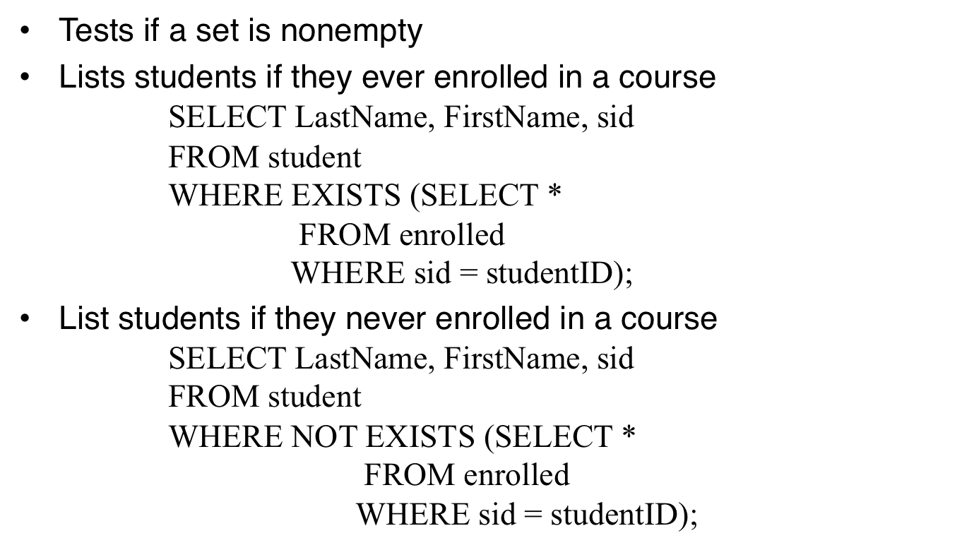
Exists

Slide 44
Subqueries
The result of one query may be needed by another to compute its result
The subquery can appear in a SELECT, WHERE, and HAVING clause when they are guaranteed to return a single value result
Subquery can appear in a FROM or WHERE clause when they return a table.

Slide 45
Returning a Single Value Result
When a single value is returned, it can be used like any other value on the right-hand side of a WHERE or HAVING condition
SELECT * FROM Student
WHERE Started <
(SELECT Max(Started) FROM Student);

Slide 46
Returning a Table in FROM clause
List departments in which the average enrollment in courses is below 2
SELECT department, avg(cnt)
FROM
(SELECT department, courseid, count(studentid) as cnt FROM enrolled, course
WHERE coursed = cid
GROUP BY courseid, department) t
GROUP BY department
HAVING avg(cnt) < 2

Slide 47
Subqueries
The result of one query may be needed by another to compute its result.
There are two kinds of subqueries
  Nested subqueries in which result of a inner subquery is used by outer subquery to compute result
  Correlated query in which each tuple of outer query runs aa loop for the inner subqery.

Slide 48
Example
Find the student who started earliest from ‘Chicago’
SELECT Student.*
FROM Student
WHERE started = (SELECT min(started)
FROM student
WHERE city = ‘Chicago’)
And then for ‘Naperville’, ’Evanston’, etc..

Slide 49
Example
SELECT Student.*
FROM Student
WHERE started = (SELECT min(started)
FROM student
WHERE city = ‘Chicago’)
UNION
SELECT Student.*
FROM Student
WHERE started = (SELECT min(started)
FROM student
WHERE city = ‘Naperville’)
UNION
(SELECT Student.*
FROM Student
WHERE started = (SELECT min(started)
FROM student
WHERE city = ‘Evanston’))

Slide 50
Correlated Subquery
SELECT Student.*
FROM Student S1
WHERE started =
(SELECT min(started)
FROM student S2
WHERE S2.city = S1.city)

Slide 51
Correlated Subqueries
A subquery may refer to attributes of the table in the outer query
The subquery will be evaluated repeatedly, once for each tuple in the table in the outer query
Attributes from outer query table must be qualified with the table name if they appear in the subquery
If the tables in the outer query and subquery are the same, must create an alias for the outer query table

Slide 52
Returning a Single Value Result
On the LHS of a WHERE clause
SELECT LastName, FirstName, SID
FROM student
WHERE (SELECT count(*)
FROM enrolled
WHERE SID = StudentID) >= 2;
As part of SELECT clause
SELECT LastName, FirstName, SID,
(SELECT count(*)
FROM enrolled
WHERE SID = StudentID) AS EnrCrs
FROM student;
Correlation

Slide 53
Practice
List members of HerCTI that are not enrolled in courses.
Courses not offered in 2013 (i.e. no record of anybody being enrolled).

Slide 54
Practice
List the oldest studentgroup
List students belonging to the first studentgroup

Slide 55
Practice
List student groups that have both graduate and undergraduate members.
List courses that have a unique number
For all departments list the highest course number used by that department

Slide 56
Practice
List students who are members of all studentgroups
List students who have taken courses in all departments
List students who have enrolled in courses every year that courses were offered

